Slide 1
REACT REDUX SAGA
BY – Chaitanya Katore,
aryan

Slide 2
Redux saga
Redux Saga is a middleware library used with Redux to handle side effects in JavaScript applications, particularly those built with React.
It simplifies the process of managing asynchronous operations, such as API calls, by using generator functions.

Slide 3
Why Redux Saga
Simplified Asynchronous Logic:
Provides a clear and structured way to handle asynchronous operations, avoiding callback hell.
Enhanced Readability:
Uses generator functions, making asynchronous code appear synchronous and easier to follow.
Centralized Side Effects:
Organizes all side effects in one place, leading to better maintainability and separation of concerns.
Effect Creators:
Built-in effect creators (call, put, take) provide a powerful API for handling side effects without directly manipulating the store.
Improved Error Handling:
Facilitates robust error handling strategies, allowing you to catch and manage errors gracefully.

Slide 4
Core Concepts of Redux Saga
Sagas:
Generator functions that manage side effects in response to dispatched actions.
Effects:
Plain JavaScript objects that describe what to do (e.g., call, put, take).
Common Effects:
call : Invokes a function (e.g., an API call).
put: Dispatches an action to the Redux store.
take: Listens for specific actions to trigger the saga.
take Every vs. Take Latest:
takeEvery: Runs a saga for every matching action.
takeLatest:Runs a saga for the most recent action, canceling any previous instances.

Slide 5
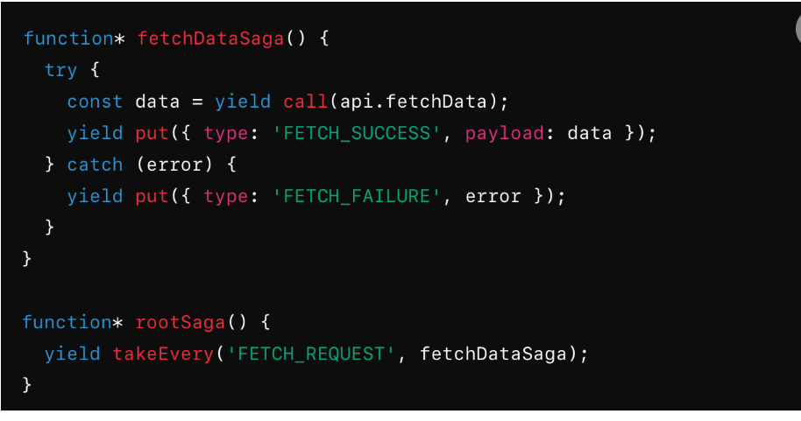
Basic code snippest

Slide 6
comparison between Thunk and Saga
Feature | Redux Thunk | Redux Saga
Approach to Async Logic | Uses functions that return another function (thunks). | Uses generator functions to handle side effects.
Testing | More challenging; requires mocking of dispatch. | Easier to test due to generator functions allowing step-by-step execution.
Control Flow | Limited control flow; may require additional logic. | Powerful control flow mechanisms (e.g., takeEvery, takeLatest).

Slide 7
Conclusion
Redux Saga is effective for managing side effects in Redux.
Clear Structure with generator functions makes async logic easier to read.
Easier Testing and robust error handling enhance maintainability.
Use Saga for complex scenarios; use Thunk for simpler ones.

